Slide 1

Pametni studentski grad - Smart Student City
Sveučilišna aplikacija osmišljena po mjeri studenata.
Dominik Juričić , Stela Šimunov, Matija Martinović, Nera Grgić
StudentHub

Slide 2
Zaboravi na 10 različitih aplikacija, web stranica i grupa, uz našu aplikaciju imaš raspored, menzu, događanja i oglasnu ploču odmah pri ruci.
Nema nepotrebnih funkcija – samo ono što ti zaista treba.

Slide 3
Problemi kod studenata
Studenti se svakodnevno suočavaju s nizom problema u organizaciji svog vremena i obaveza:
Nepregledne informacije
Sve je razbacano
Neke infromacije su na oglasnoj ploči neke na stranici
Infromacije na različitim stranicama
Infromacije dostupne na internetu su sve na različitim stranicama
Loša povezanost i komunikacija
Informacije ne dolaze do svih studenata jednako

Slide 4
Naša rješenja
Student Hub
Raspored, kalendar, menza, gužva u menzi, oglasi itd.. se nalaze na jednom mjestu.
Jednostavan, brzi pregled svih potrebnih informacija.
StudentHub integrira podatke koje inače moraš tražiti na više mjesta:
Stanje na ixsici
Tjedni raspored
Konflikti u rasporedu
Meni i gužva u menzi
Događanja na faksu i u gradu
Oglasi i razmjena među studentima

Slide 5
UniHub
Student Hub se oslanja na

Slide 6

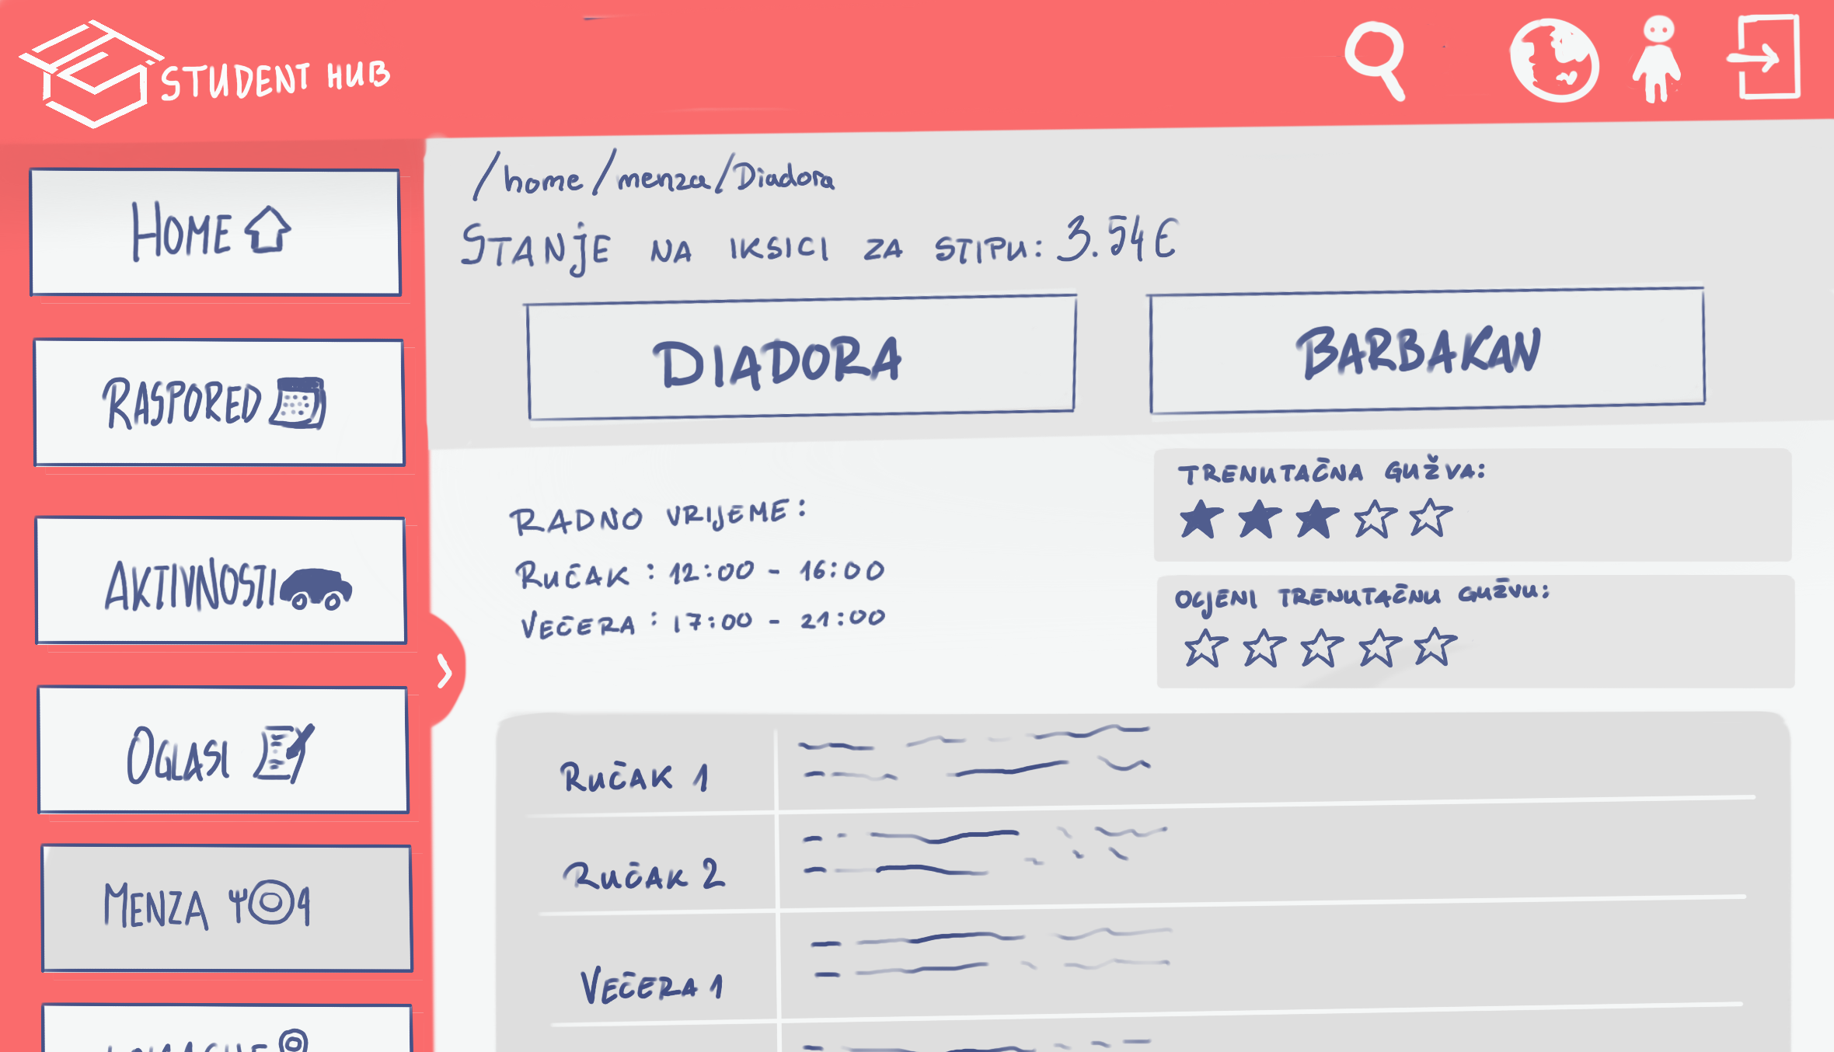
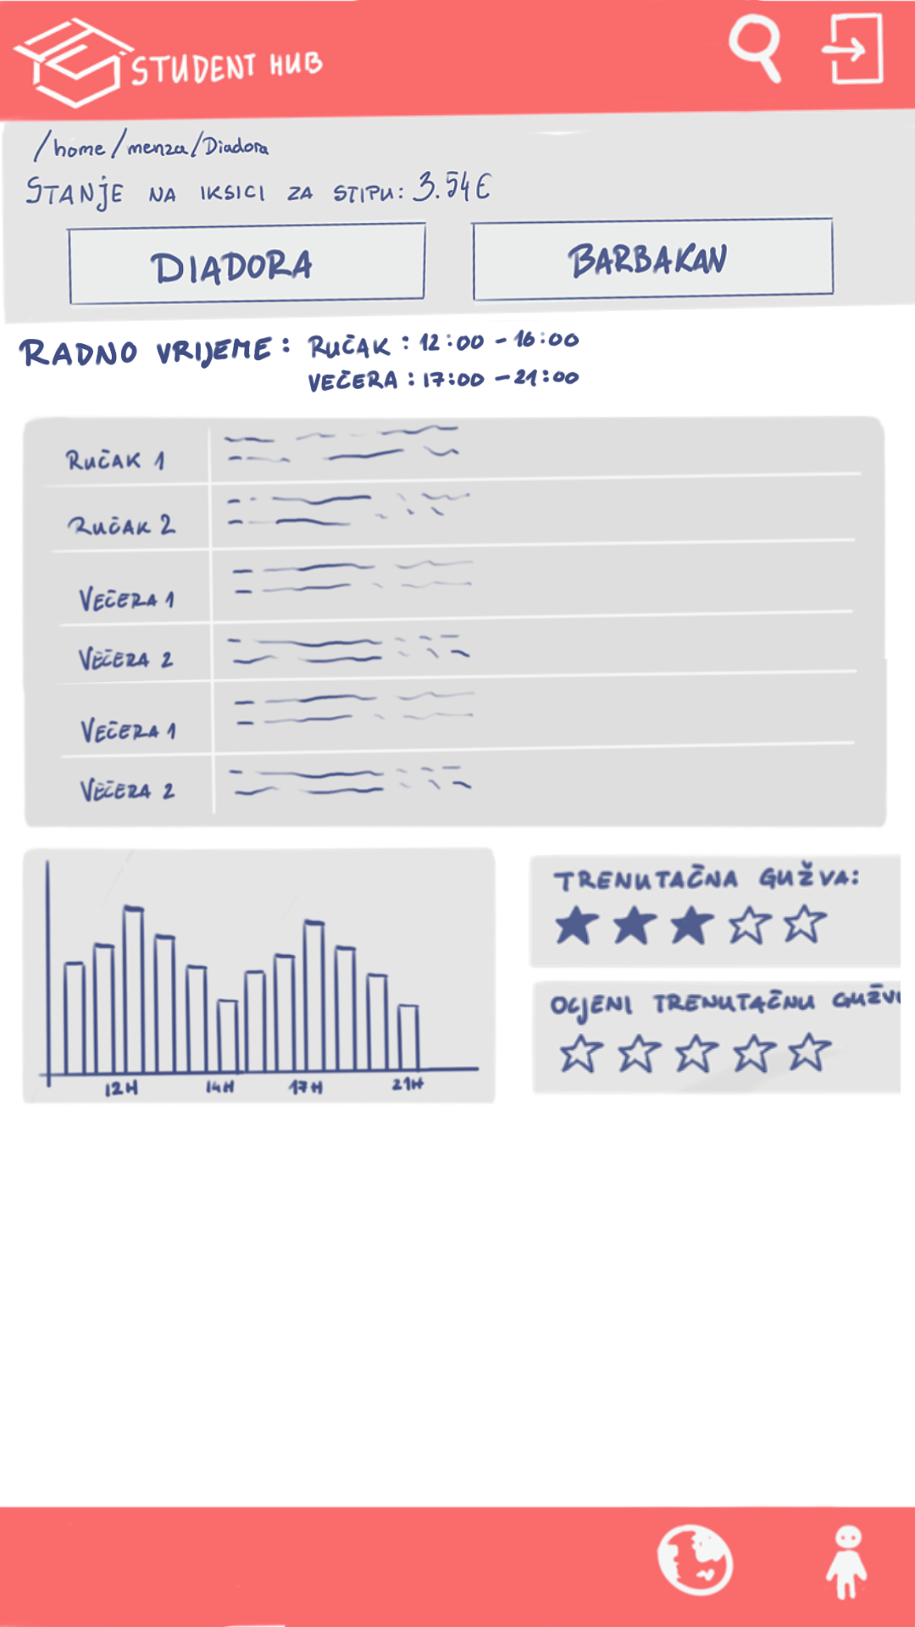

Slide 7
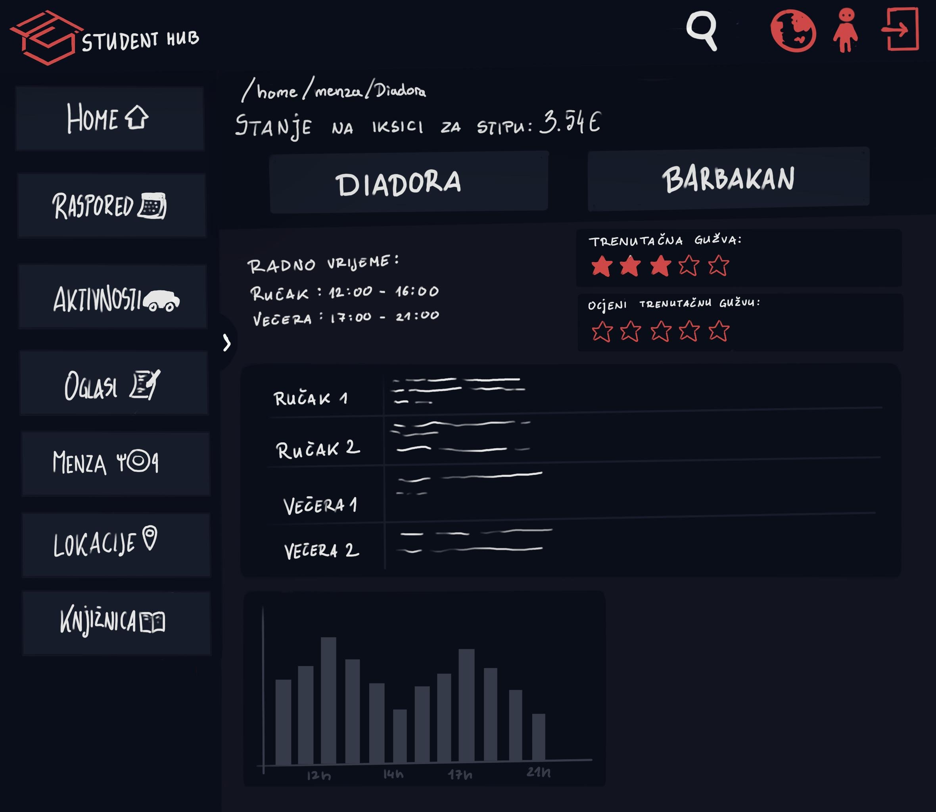
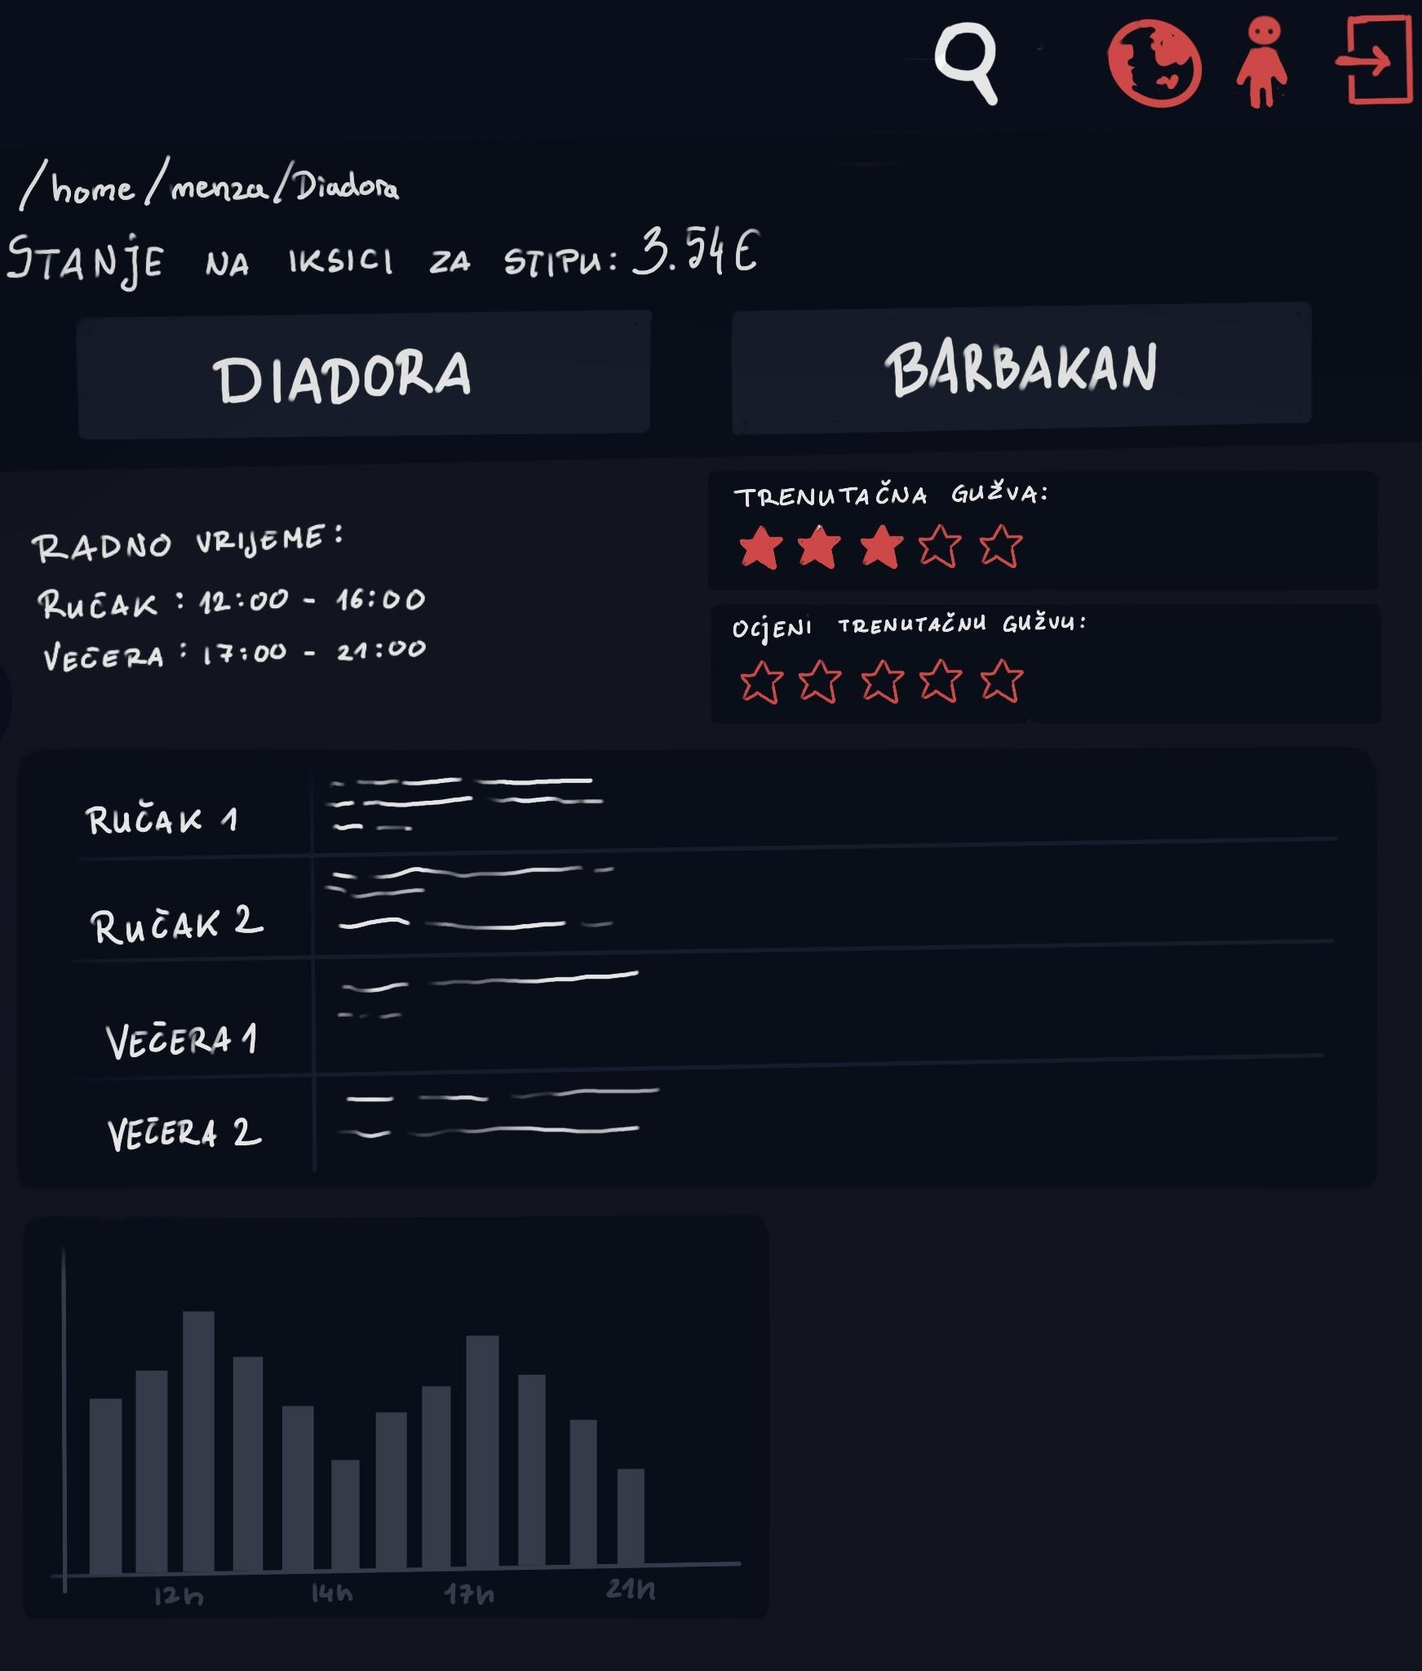

Slide 8
Moduli
Home | Welcome page, nadolazeći događaji, gužva u Menzi, dodatne aktivnosti
Raspored | Kalendar sa aktivnostima i predavanjima
Aktivnosti | Slobodne aktivnosti na faksu (Klubovi, rekreacije i događaji)
Oglasi | Studentski oglasi podijeljeni po kategorijama
Menza | Trenutni status na iksici, dnevni meni i gužva u menzama
Lokacije (neimplementirano) | Prikazuje lokacije i radno vrijeme studentskih objekata
Knjižnica (neimplementirano) | Laka pristupačnost dostupnih knjiga

Slide 9
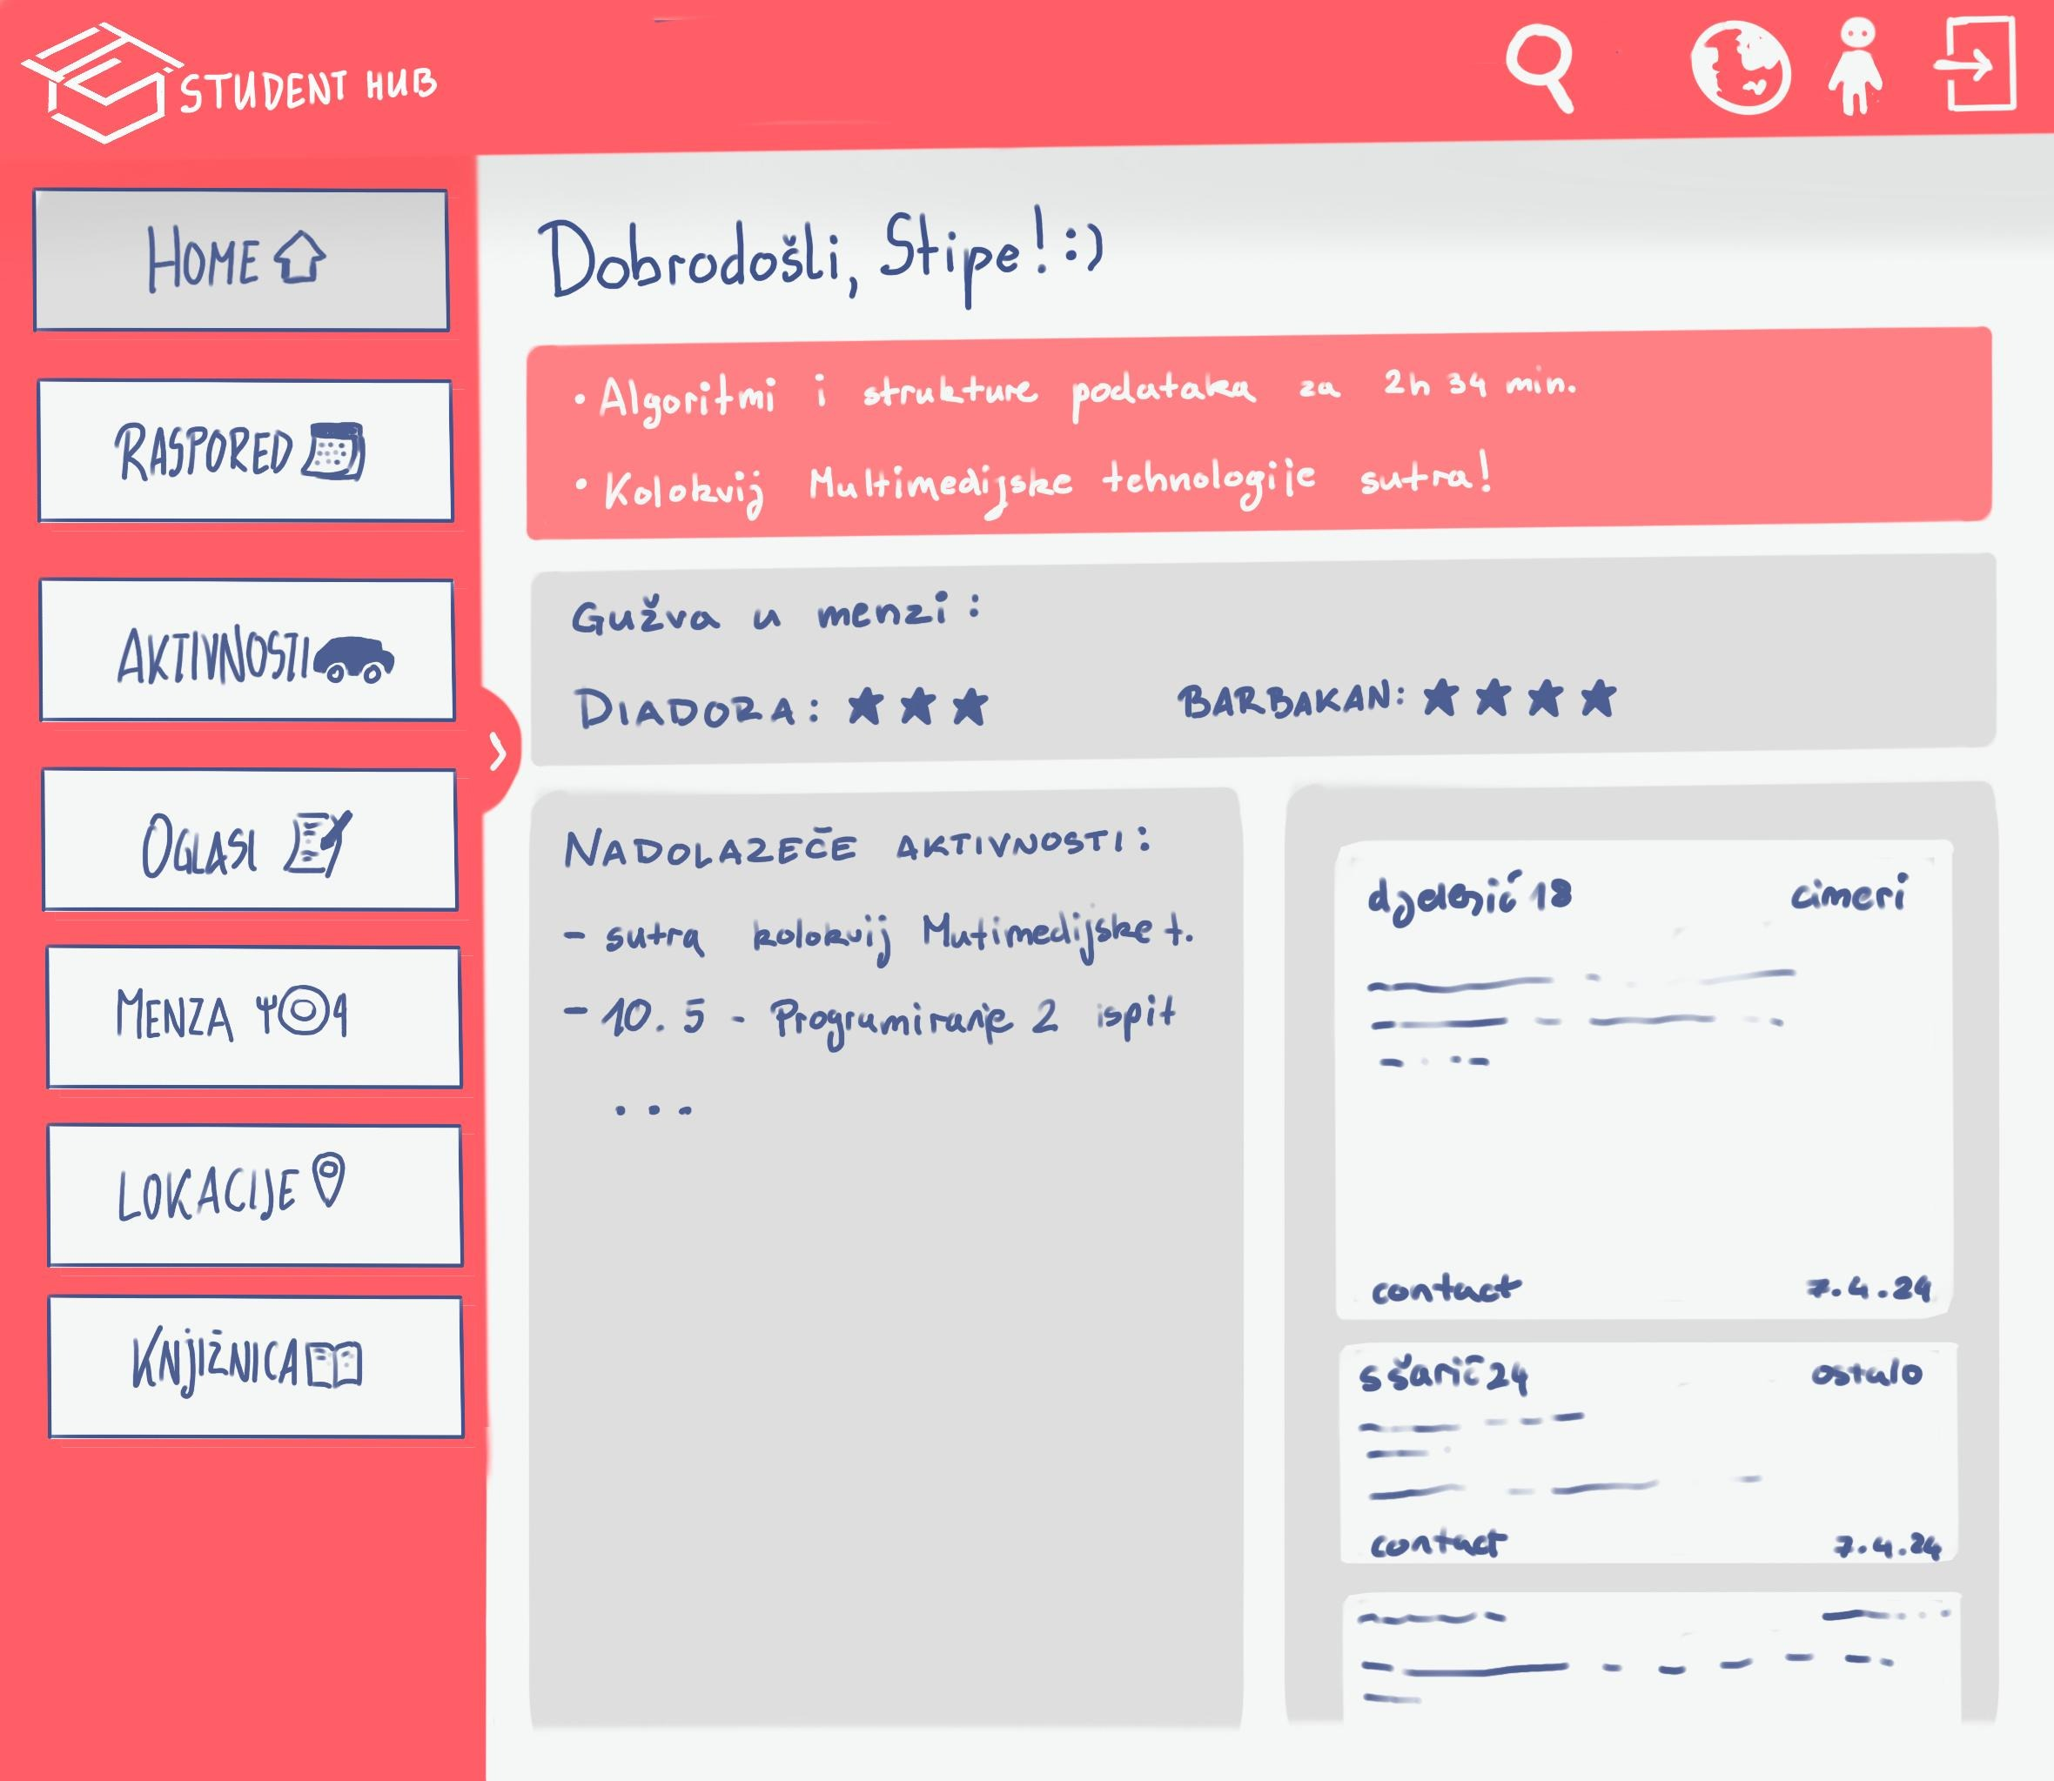
Home
Prikazuje ime korisnika i aktualni datum
Prikaz vremenske prognoze za Zadar (ikona + temperatura + opis)
Kratka poruka o vremenu (npr. "Savršen dan za šetnju")

Slide 10
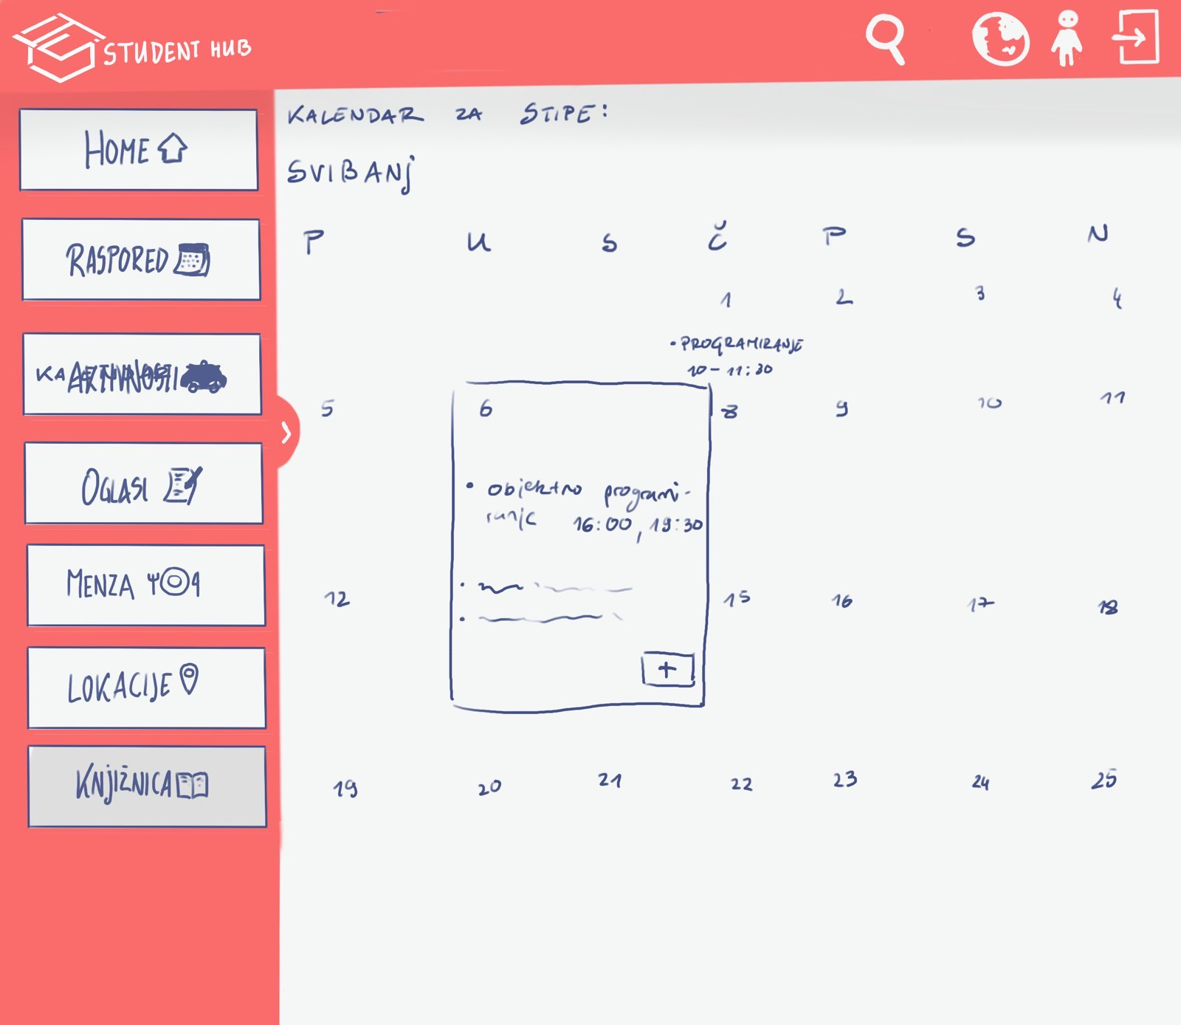
Raspored
Home

Slide 11
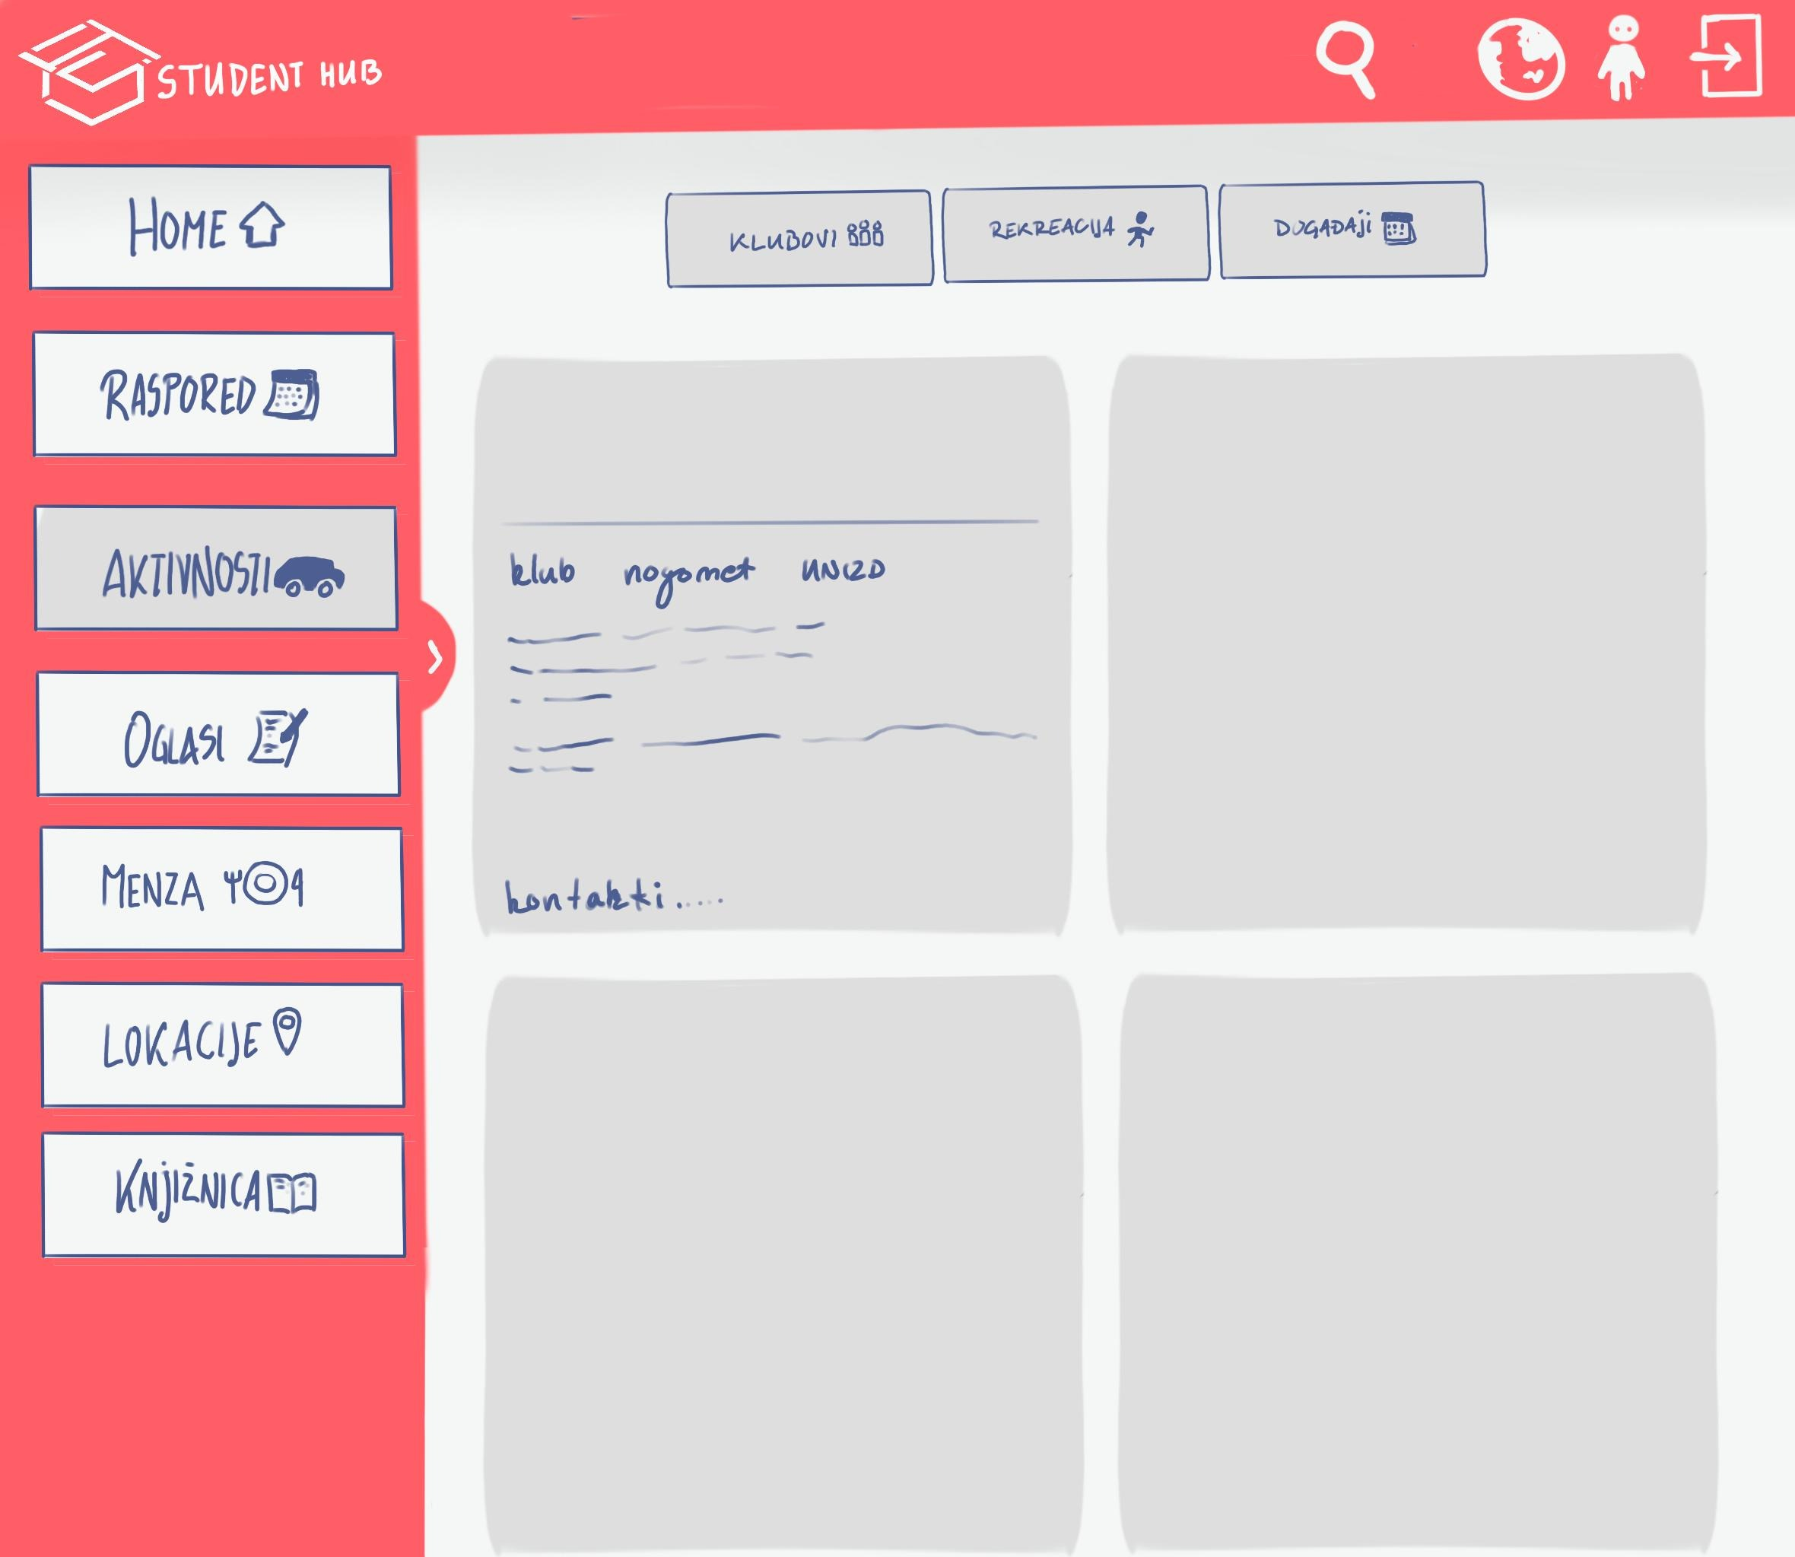
Aktivnosti
Home

Slide 12
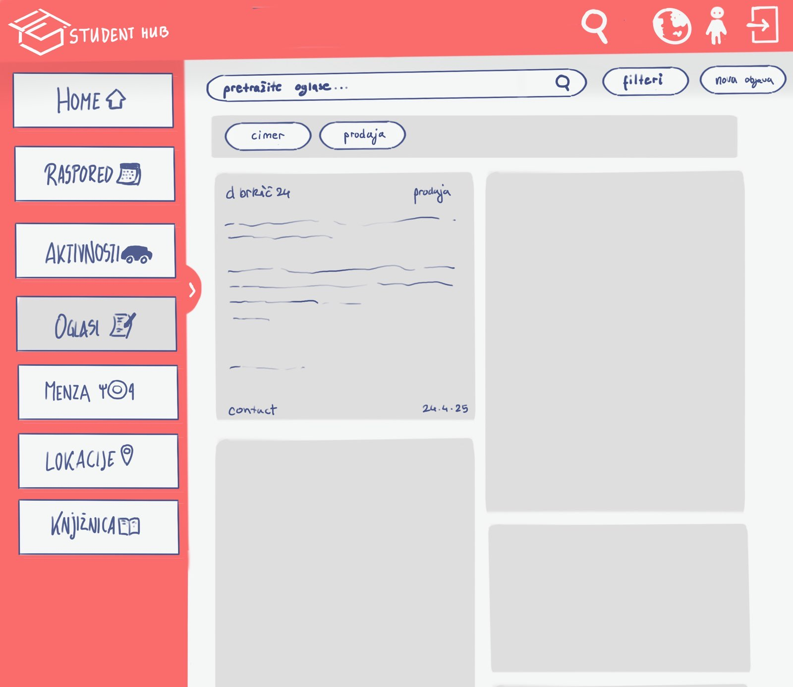
Oglasi
Digitalna oglasna ploca omogucuje jednostavno oglasavanje unutar kampusa
Prijava putem AAI@EduHr racuna
Kategorije oglasa
Gumb za objavljivanje
Search bar i filteri

Slide 13
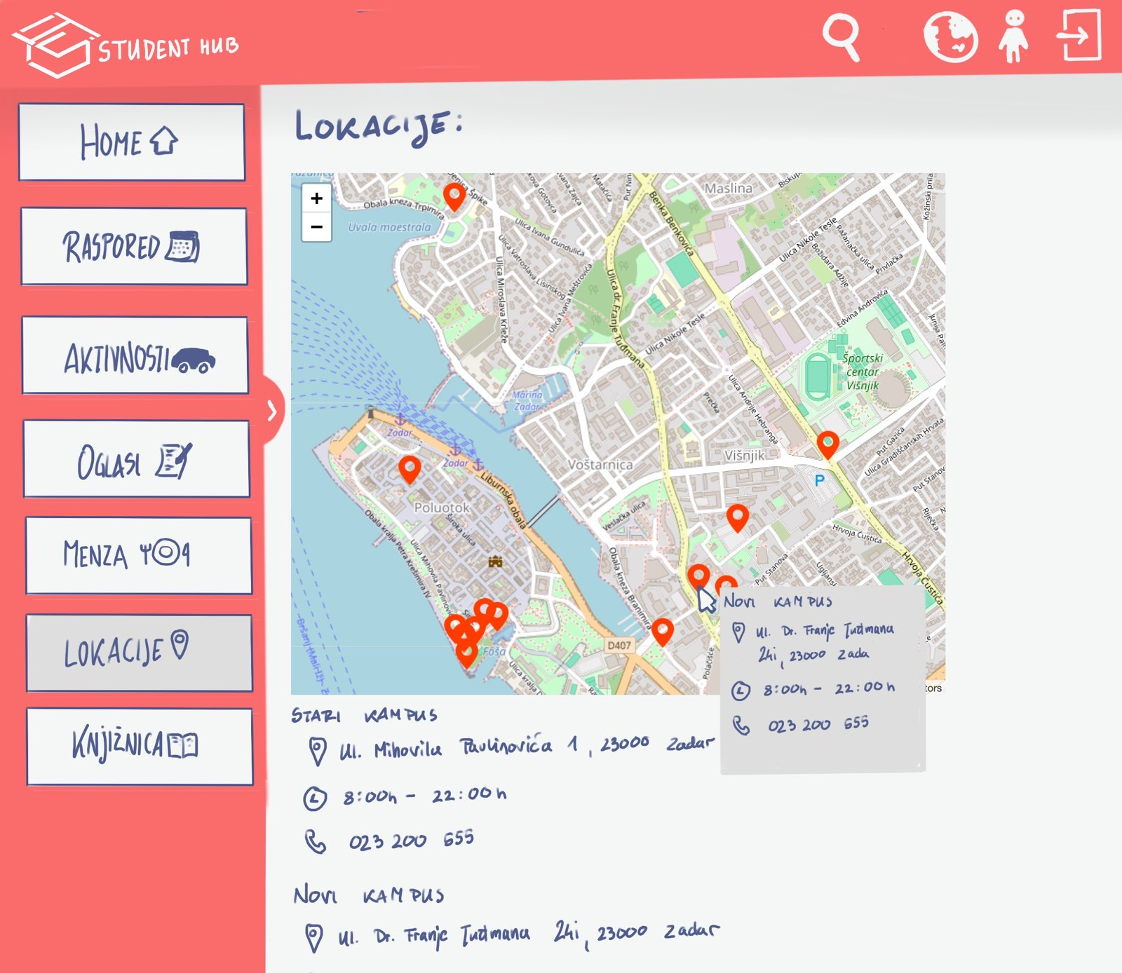
Lokacije
Home

Slide 14

Executive summary
Our business plan outlines the strategy for [company name], a [legal structure] that provides [products/services] to [target market]. Our mission is to [mission statement/goal of the company]
The market analysis shows that there is a high demand for our products/services in the industry. We have identified key competitors and believe we can differentiate ourselves through our unique selling propositions (USPs)

Slide 15
01
Business plan
Company name

Slide 16
Company description
From where we started to where we’re going
Provide a brief history of your company, including when it was founded and its evolution over time. Then, describe your company's vision for the future and its long-term objectives
Our management team leads with experience
Describe the key members of your team, their roles and responsibilities, and their relevant industry experience. Highlight any unique skills or qualifications that set your team apart from competitors to establish credibility with potential investors or partners

Slide 17
Market analysis
How we stand out in a competitive market
Analyze the competitive landscape for your industry, identify key competitors and their strengths and weaknesses. Then, you can explain how you plan to differentiate yourself and your business from them
Key trends shaping the industry
Who we’re targeting and why it matters
Provide a brief overview of your industry, including its size and growth trends. Identify key players in the market and any regulatory or technological changes that could impact your business or company
Describe your target customer segment(s) in detail, including demographics and psychographics, and explain why they represent an opportunity for your product or service

Slide 18
Marketing & sales strategy
Who we’re targeting and why
The value we offer to our customers
These are our key marketing channels
Identify your target audience, including demographics, psychographics, and
buyer personas
Clearly communicate the unique value that your product or service provides to customers compared
to competitors
Outline the channels you will use to reach your target market, such
as social media,
email marketing…
How we convert leads into customers
How we compare to our competitors
Key metrics and performance goals
Describe how you plan to convert leads into customers through your sales process
Analyze the strengths and weaknesses of your competitors in terms of their products/services, pricing strategy…
Define key performance indicators (KPIs) that measure the success of your marketing and sales efforts. Set specific goals

Slide 19
$4,498,300,000
Budget for the new products of the company
Company name

Slide 20
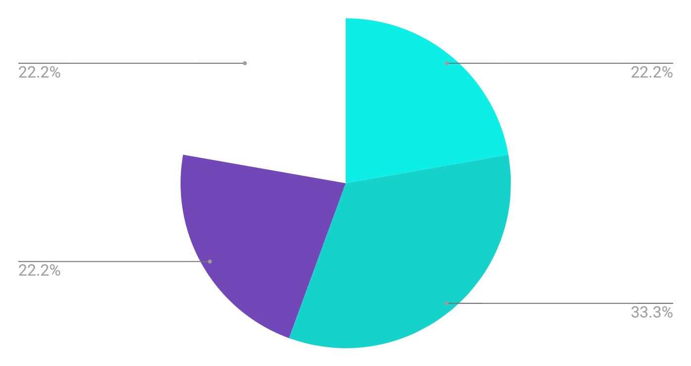
Budget for this quarter
 | Q1 | Q2 | Q3 | Q4 | Total
Research | $50,000 | $60,000 | $75,000 | $90,000 | $275,000
Product development | $20,000 | $24,000 | $30,000 | $36,000 | $110,000
Talent acquisition | $15,000 | $18,000 | $20,000 | $24,000 | $77,000
Marketing | $7,000 | $8,000 | $9,000 | $10,000 | $34,000
Understanding the numbers
Incorporating a graph in your business plan allows for the clear visualization and concise representation of data trends and comparisons, making complex information easier to understand
Follow the link in the graph to modify its data and then paste the new one here. For more info, click here

Slide 21
Business plan timeline
Step 01
Step 03
Step 05
Mercury is the closest planet
Earth is the third planet
Jupiter is the biggest planet
Step 02
Step 04
Step 06
Venus has a beautiful name
Mars is actually a cold place
Sun is the star at the center

Slide 22
My business strategy
Attractive business model
Growth and expansion strategy
Reorientation or abandonment strategy
High competitive strength
Low competitive strength
Maintenance and protection strategy
Reduction or elimination strategy
Unattractive business model

Slide 23
Market size infographic
$100 M
$100 M
"With the innovative approach and unique features, we aim to capture a significant portion of the $100 million"
$20 M
$20 M
"The research indicates that the market for [product/service] is projected to reach $20 million by next year"
$5 M
$5 M
"The market for [product/service] is currently valued at $5 million"

Slide 24
Alternative resources
Did you like the resources used in this template? Get them on these websites:
Photos:
People working with ai operated devices I
People working with ai operated devices II
Gradient grainy texture
Round bubble spheres of northern lights background
Abstract northern lights background with defocused coloured shapes

Slide 25
Resources
Here’s an assortment of alternative resources whose style fits that of this template:
Abstract blue northern lights background
People working with ai operated devices

